Slide 1
Scope Creep
Pratim Patel, Liam King, Brandon Patton, Samuel Grinberg, Tarquin Bennett, Justin DeTone

Slide 2
What is Scope?
Scope is determining and documenting a list of specific project goals, deliverables, tasks, etc.
Shows what the project will entail so everyone is on the same page
Makes everyone share a common goal
Is meant to keep the project from changing along the way
According to the PMI, 44% of all projects suffer from scope creep
Notes:
Pratim

Slide 3
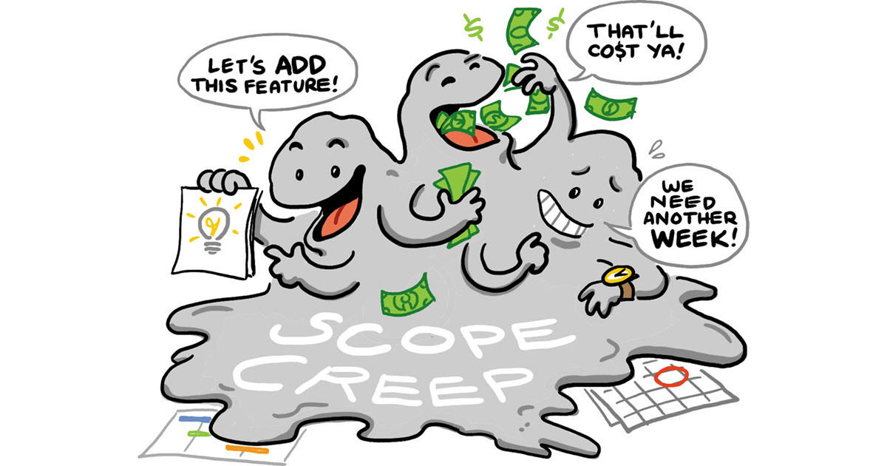
What is a Scope Creep?
Scope Creep is when additional features are added to a project that aren’t covered in the scope
Not all scope changes are inherently bad
Sometimes scope changes are necessary
Scope change is when an official decision is made by PM and client to change functionality
Scope Creep happens unofficially
The client is not aware, but can be the cause
A project will grow in size as this happens
Notes:
Pratim

Slide 4
What causes Scope Creep?
-Project teams often try to impress project sponsors, and put too much value in exceeding expectations.
-Project teams try to damage control lost resources by extending the scope, rather than providing what was needed.
-Project sponsors want to add more onto the project or change something in the project
-The initial requirements of the project may have been undefined or vaguely defined.
Notes:
Tarquin

Slide 5
Why Scope Creep is bad
Creating more project requirements hurts likelihood of meeting those requirements
Especially when initial scope couldn’t be met
They go against initial planning
Planning in advance is key
Can cause a project to go over budget and/or beyond the deadline
Stakeholders lose confidence
Notes:
Tarquin

Slide 6
Is it always bad?
Customers stand to benefit
Reevaluation
Increase revenue streams
Customer retention for businesses
Notes:
Samuel

Slide 7
How to address Scope changes
Removing something from the project if something new is added can keep things from getting out of hand
Charge the customer for features they would like to add
Decide who will handle which changes when they come up
Notes:
Samuel

Slide 8
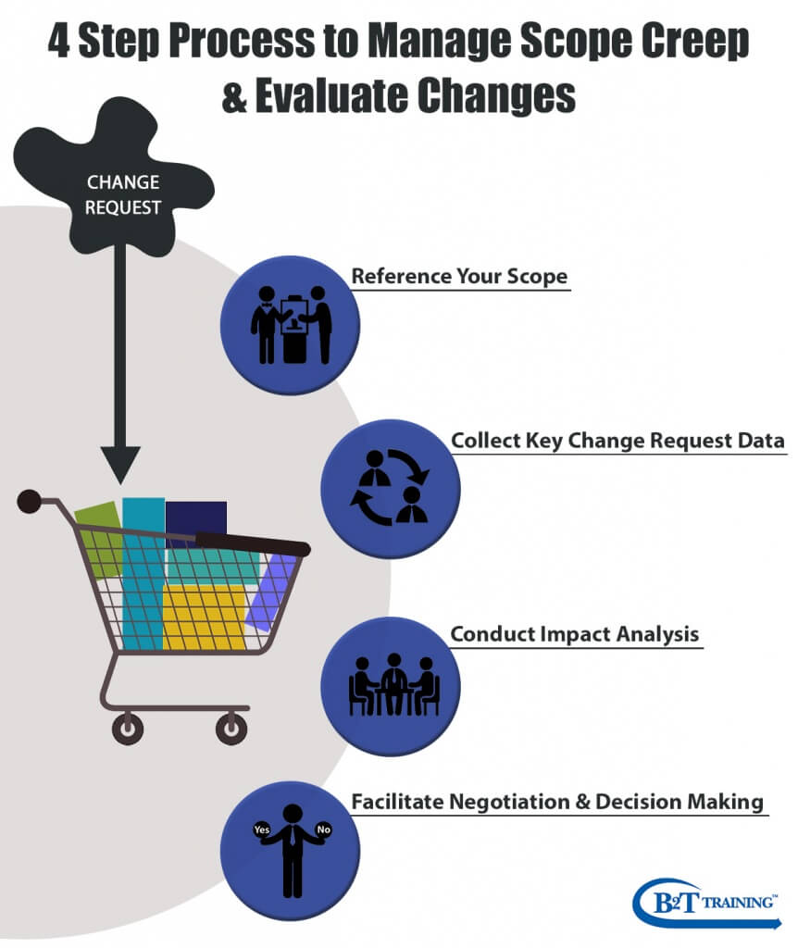
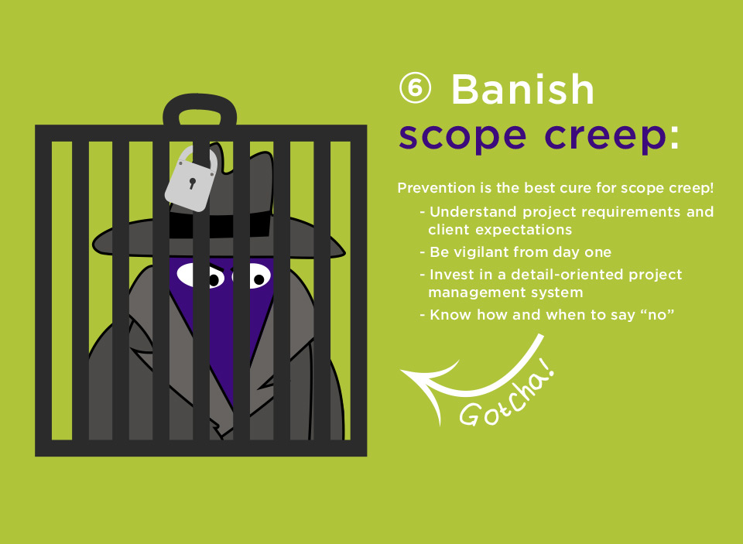
Notes:
JustinJustin

Slide 9
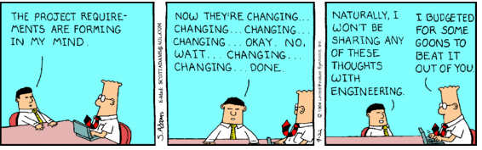
How to prevent Scope Creep
Define the scope of the project well before the start of the project.
Ensure that all members of the project understand the scope, and the importance of sticking to the defined scope.
Give the project team goals and benchmarks to help them stay on task.
Notes:
Justin

Slide 10
Real World Example
Boeing Business Jets were added to the fleet of a private jet charter management company.
The new planes were larger than the others, so a new, larger hanger had to be constructed.
IT Manager offered to help out with the network and communications requirement, but was told that the subcontractors and contractors had it covered.
Notes:
Brandon

Slide 11
Real World Example (cont)
Towards the end of the project, the subcontractor called the IT manager, asking about the network requirements.
A meeting was called between the contractors and the managers and VPs of the company.
Instead of just resolving the phone and network issues, the VP wants to instead install a brand new phone system for the building, at a cost of $60,000.
If this project was well managed, the new phone system could have been planned for, and budgeted for.
Notes:
Brandon

Slide 12
Real World Example 2
The National Health Society of England put together a project to digitize patient records
It began in 2002 with a cost estimate of £2.3 billion
It received a lot of criticism for being behind and running over budget
It was terminated in 2011 after costing £12.7 billion
Notes:
Liam

Slide 13
Real World Example 3
The Expeditionary Combat Support System was a project for the USAF that started in 2005
Its purpose was to improve logistic operations by replacing legacy systems
It was terminated in 2012 after spending $1.1 billion and only achieving a quarter of the original scope
“Most egregious example of mismanagement in recent memory”
Notes:
Liam

Slide 14
Conclusion
Scope lays out specifications of the project
Scope creep can lead to overspending and stretching beyond deadlines
Almost 50% of projects suffer from scope creep
Scope creep has some positive side effects
Preventable
Notes:
Liam

Slide 15
Sources
https://www.pmi.org/learning/library/top-five-causes-scope-creep-6675
https://www.wrike.com/project-management-guide/faq/what-is-scope-creep-in-project-management/
https://www.liquidplanner.com/blog/manage-scope-creep-even-prevent-happening/
https://www.techrepublic.com/blog/tech-of-all-trades/real-world-example-of-scope-creep/

